Slide 1
Fostering Data Conversations that Support Guided Pathways Planning
Download this presentation:
bit.ly/gfsf-data

Slide 2
LaunchBoard Tabs

Slide 3
1) Who are we serving?
Data Conversations:

Slide 4
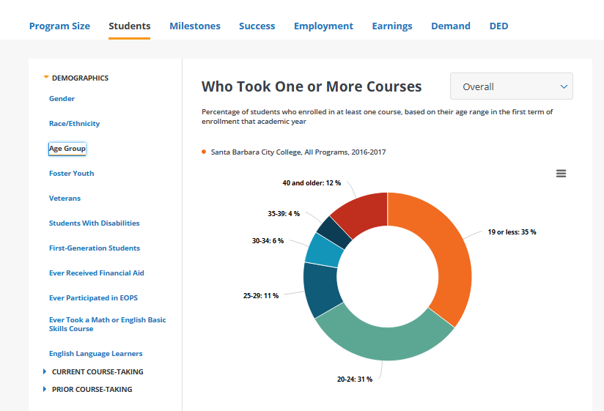
Clarify Your Current Market
Program Tables Tab

Slide 5
Clarify Your Current Market
This information could be used to discuss issues such as:
Where would additional marketing and outreach be fruitful?
How could scheduling be adjusted meet the needs of students?
Does the program content align with the experience level of participants?

Slide 6
2) How engaged are students in their first year?
Data Conversations:

Slide 7
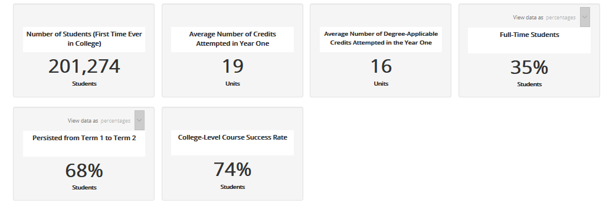
Understand The Intensity of Course-taking
Guided Pathways Tab

Slide 8
Understand The Intensity of Course-taking
This information could be used to discuss issues such as:
Why don’t students enroll full time?
Why don’t students come back for a second term?
How many non-degree-applicable courses are students taking and what is the benefit of these courses?

Slide 9
3) Can Students get through transferable math and English in their first year?
Data Conversations:

Slide 10
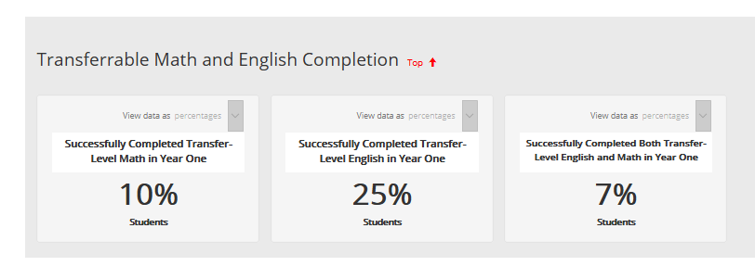
Evaluate Basic Skills Practices
Guided Pathways Tab

Slide 11
Evaluate Basic Skills Practices
This information could be used to discuss issues such as:
How is college readiness evaluated for most students?
Why are English results so much better than math?
What types of curriculum are students expected to complete?

Slide 12
4) Do we have strong on-ramps to Transfer for high school Cte students?
Data Conversations:

Slide 13
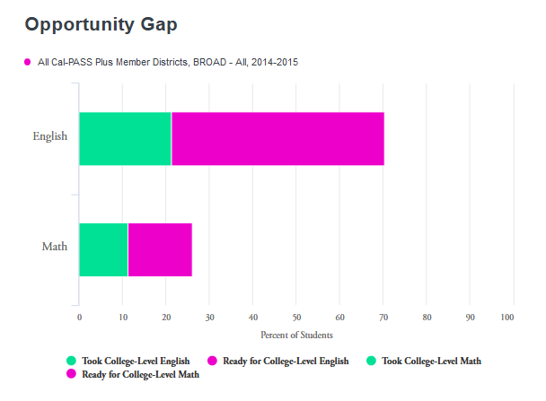
Examine College Readiness Gaps
K-14 CTE Transition Tab

Slide 14
Examine College Readiness Gaps
This information could be used to discuss issues such as:
How could multiple measures be scaled?
Which math and English skills are needed by CTE students?
Does curriculum or advising need to be aligned with high school partners?

Slide 15
5) Are our students entering a pathway in their first year?
Data Conversations:

Slide 16
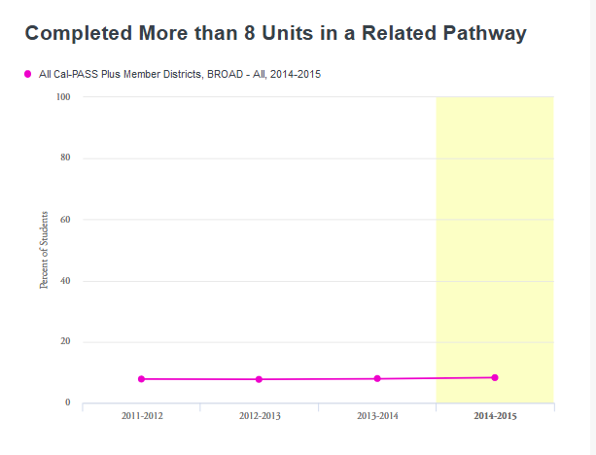
Examine First Year Pathway Progress
K-14 CTE Transition Tab

Slide 17
Examine First Year Pathway Progress
This information could be used to discuss issues such as:
What is the ideal balance of basic skills and major courses in the first year?
Does scheduling allow students to make progress in a year?
How could students be informed about courses relevant to their major?

Slide 18
6) Which pathways are improving earnings?
Data Conversations:

Slide 19
Clarify How College Impacts Employment
Strong Workforce Program Tab

Slide 20
Clarify How College Impacts Employment
This information could be used to discuss issues such as:
What is enabling or hindering students from getting the jobs they trained for?
Does college seem to be helping students secure economic mobility?
How could more students attain a living wage?

Slide 21
7) Where are there equity gaps?
Data Conversations:

Slide 22
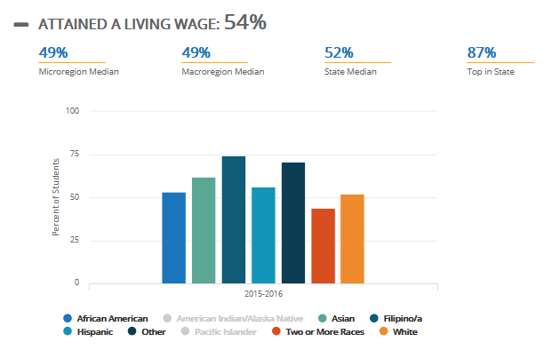
Examine Gaps in Access and Success
Strong Workforce Program Tab

Slide 23
Focus On How to Close Gaps
This information could be used to discuss issues such as:
What is contributing to gaps in student outcomes?
What are lessons learned from programs that have minimized gaps?

Slide 24
8) How does my program fit into longer-term pathways?
Data Conversations:

Slide 25
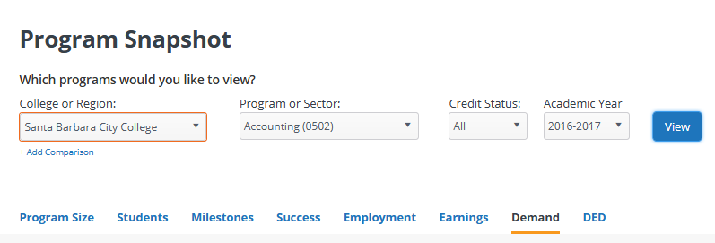
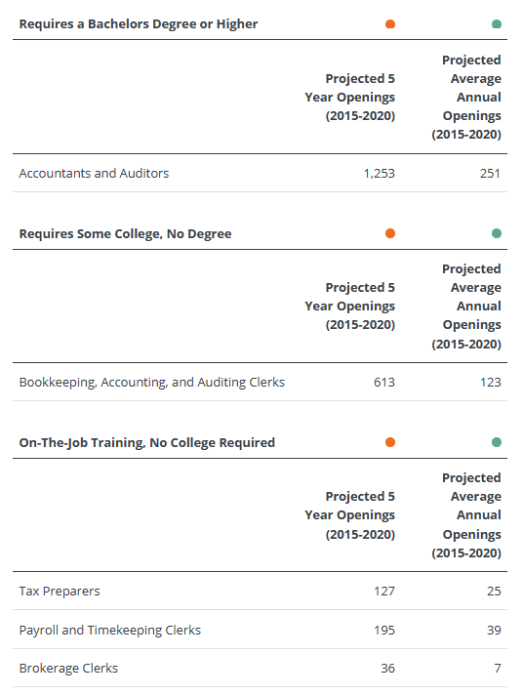
Examine Longer-Term Educational Options
There are 194 projected job openings for non-bachelor’s degree, accounting-related jobs per year in the South Central Coast Region.
There are 251 job openings for people with bachelor’s degrees.
Program Tables Tab

Slide 26
Develop Long-Term Pathways
This information could be used to discuss issues such as:
Do existing offerings fit into a stackable pathway?
Can short term programs be linked to transfer pathways?
How could the value of ongoing education be communicated to students?

Slide 27
9) How does my program fit into the regional context?
Data Conversations:

Slide 28
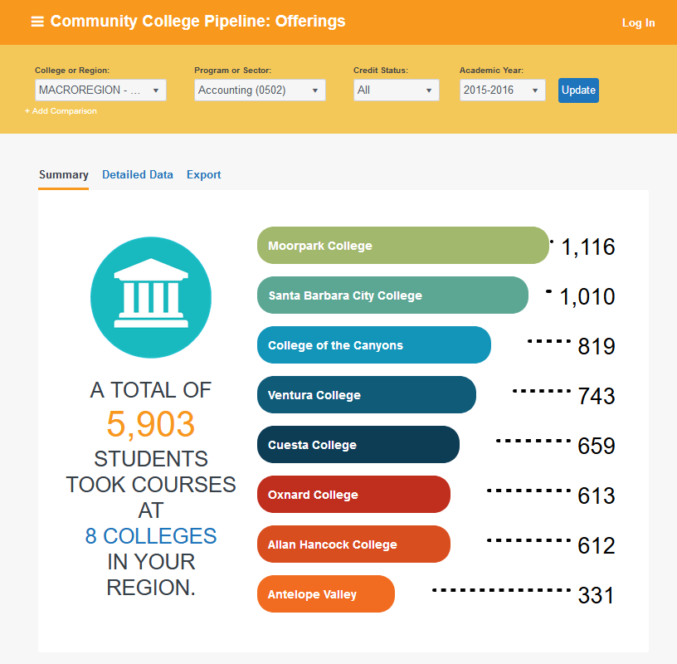
Understand Who Else Offers Programs
445 < 5,903
Community College Pipeline

Slide 29
Understand Who Else Offers Programs
This information could be used to discuss issues such as:
Is the region flooding the job market?
How does curriculum at my college relate to offerings at other colleges?
What action could be taken to support swirling students in attaining completion?

Slide 30
10) Where does this information come from?
Data Conversations:

Slide 31
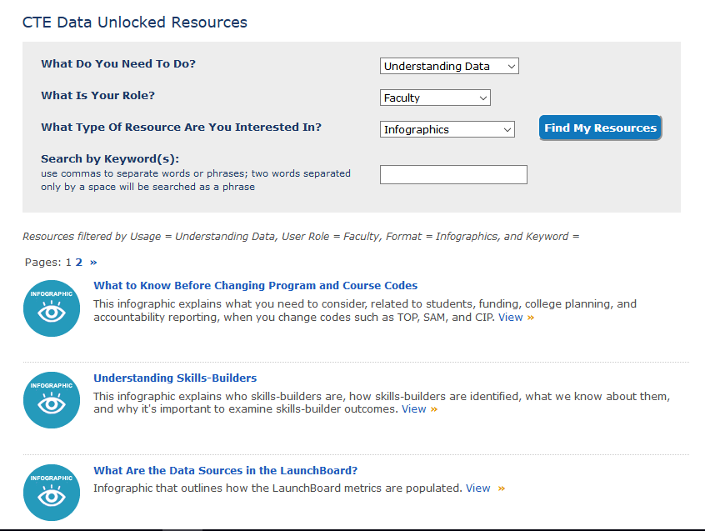
Build Data Literacy

Slide 32
Build Data Literacy
This information could be used to discuss issues such as:
How should we evaluate and triangulate data sources?
How can we pair qualitative and quantitative information to better interpret results?
How can we move past methodology to discussing results?

